Slide 1
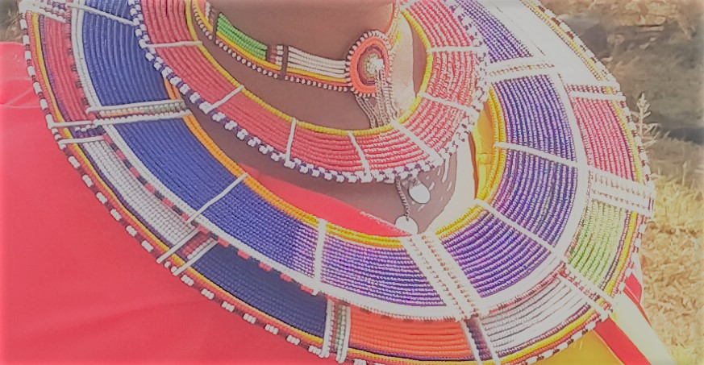

ERISHINA ANG COMMUNITY BASED ORGANIZATION
A grass root community organization empowering Indigenous women and children in Kenya,Kajiado County

Slide 2
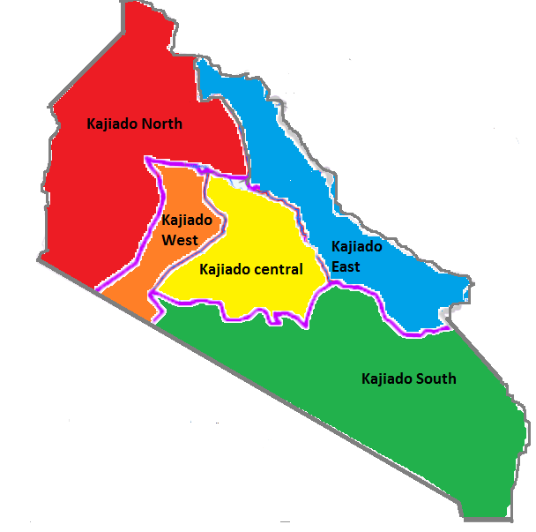
Kajiado County…
PROJECT AREAS
1.Kajiado East
2.Kajiado West
3.Kajiado Central

Slide 3
Erishina Ang’ Community Based Organization
A Non governmental, political and Non profit Indigenous Organization founded in 2017.
Its main goal is to socially, economically and politically empower vulnerable women and children in the Maasai Communities.
High levels of poverty, low income, retrogressive culture,HIV/AIDs among other challenges have left these families vulnerable. It has denied them rights to access basic needs and degrading their value in the society.
Our main goal is to see a socially and an economically empowered community which will be able to address its needs through appropriate and sustainable interventions.
Through capacity building we build positive strengths, use untapped resources, skills and knowledge among the community.
We use a holistic approach to target all groups in the community as we collaborate with relevant development partners to leverage resources and provide quality services.

Slide 4
Program Structure….
Board of Directors
Program Coordinator
Development Partners
Program Manager
Administration /Finance
Project Sectors
Organized community groups
Larger community
Community Volunteers

Slide 5
Erishina Ang Cont…..
Vision and Mission
Target groups
Vision
A Self Reliant and empowered Community that promotes social, economic, cultural and moral development
.
Mission: To empower the disadvantaged women and children in the community through appropriate and sustainable initiatives.
Vulnerable women and children
Women and Youth groups
Learning Institutions
Faith Based Organization

Slide 6
Summary of Target groups….
The Maa community is our main focus
These community have deep rooted traditions and culture, both negative and positive
The communities structures stand at men dominate and they are the main decision makers in almost everything. Focus our projects on opportunities where men do not have interest in it.
Their livelihood(Keeping cattle) is a priority, we sensitize them on diversity and other emerging issues.
Most of them have non- formal education and other challenges so we treat every group individually.
We focus on using existing resources, skills and knowledge to improve lives of both women and children.
There are retrogressive culture-we are fighting against,i.e (FGM,Early Marriages) we will keep on fighting against.
In all our projects we collaborate with development partners and government for leveraging resources, technical and financial support.
Collaboration and Networking with relevant partners is a cross cutting issue in all our interventions.

Slide 7
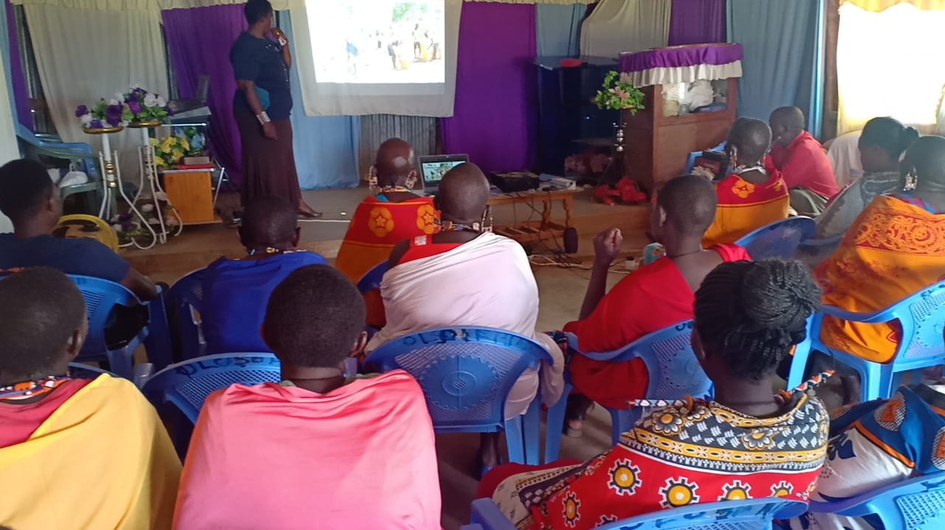
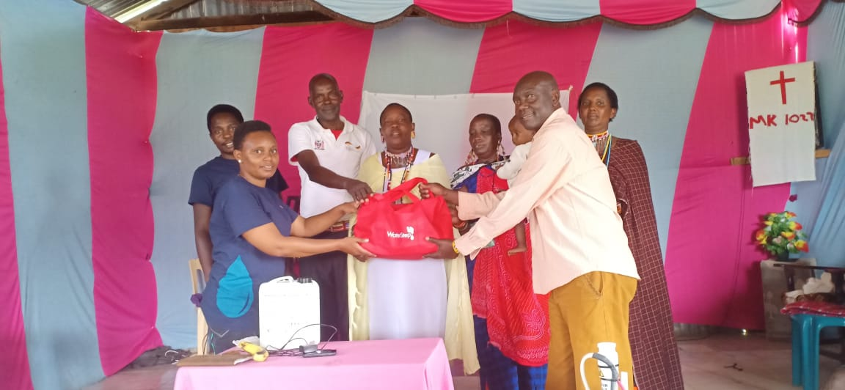
1.Capacity Building and Advocacy
Enhance Access to information.
Access to information through trainings, awareness creation sessions and sensitization.
Enhance collaboration from the County government for technical support.
General community education on emerging issues.

Slide 8
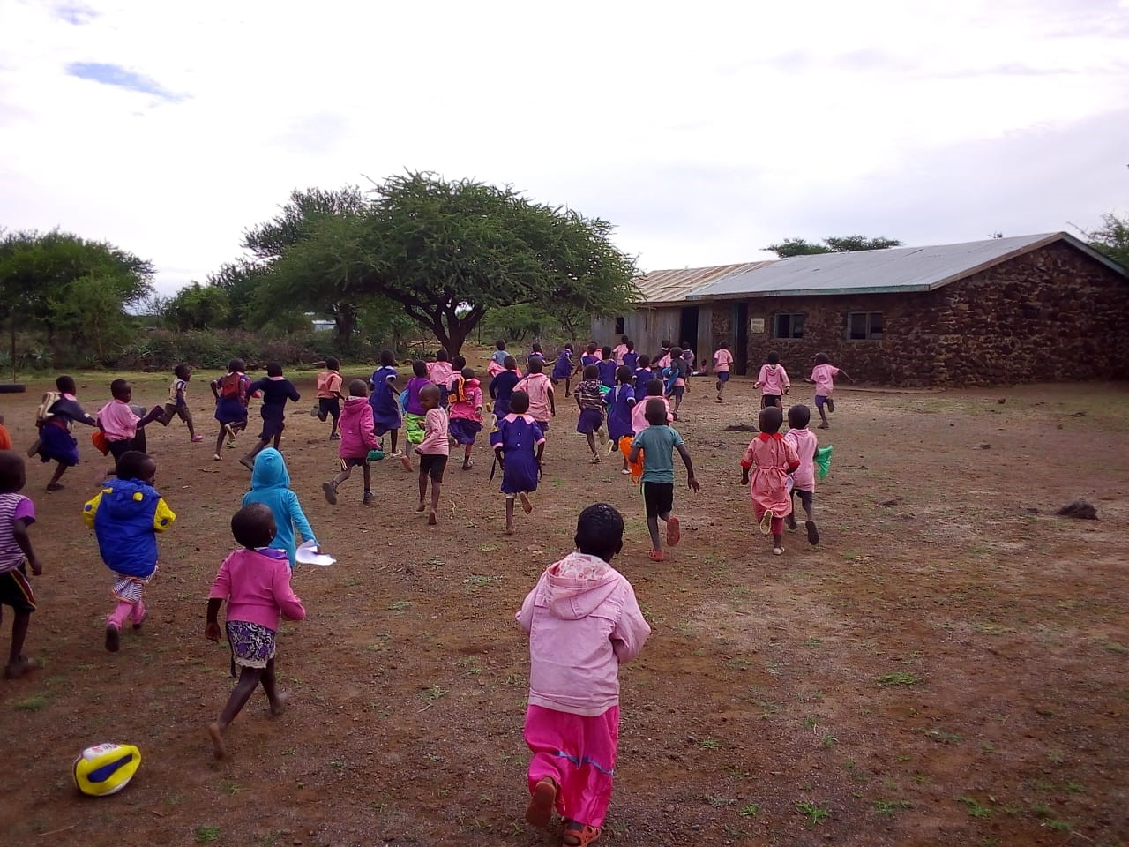
2.Education and Technology
Access education and enhance transition, retention and completion(Primary,secondary,tertiary levels}
Support vulnerable children through scholarship programs(Secondary,Vocational trainings for those with lower grades)
Established a libraray to enhance learning-(Through community support –old and new books)
Mentorship programs in schools-reaching the new generation.

Slide 9
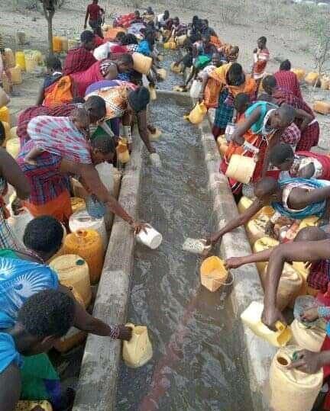
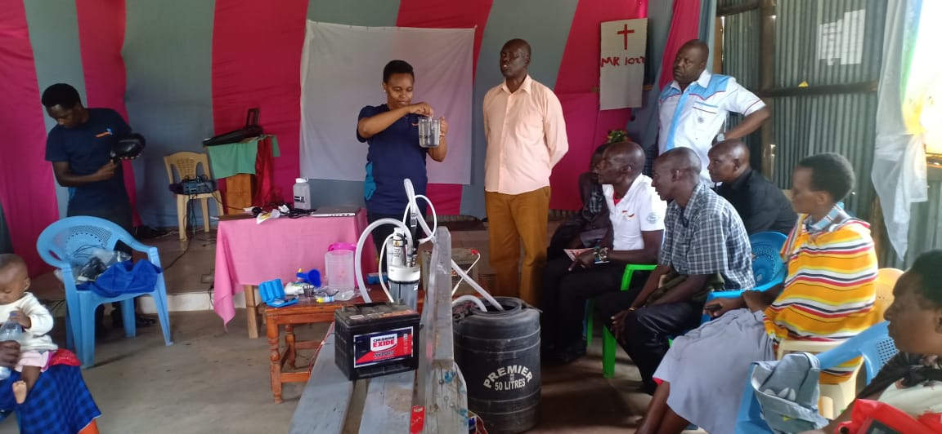
3.Environment, Health & Water
Promote environmental protection, access to good health, clean and safe water.
Access information on how to conserve the environment through promoting tree planting and preserving the existing forests.
Access to information on health, both preventive and curative services(Especially for the vulnerable groups}
Access to clean and safe water for drinking at the household levels.
Educate the community of different methods of water harvest during the rainny season.

Slide 10
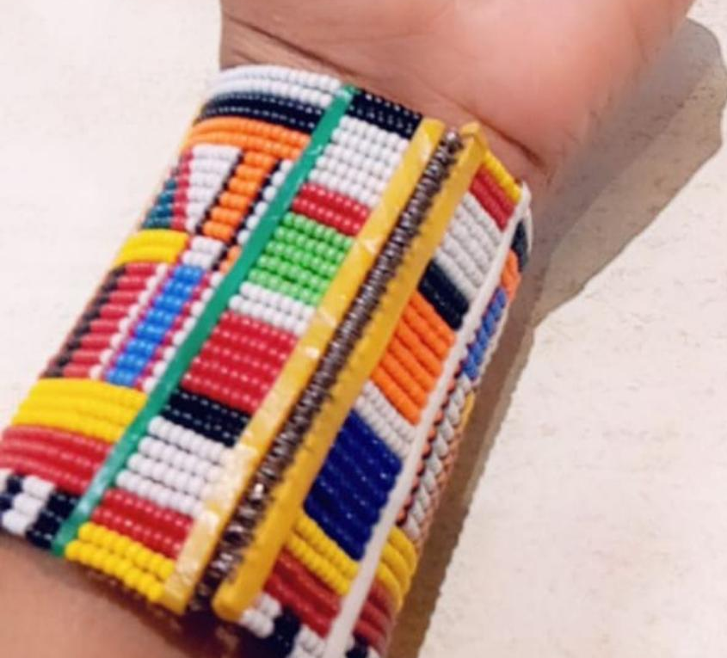
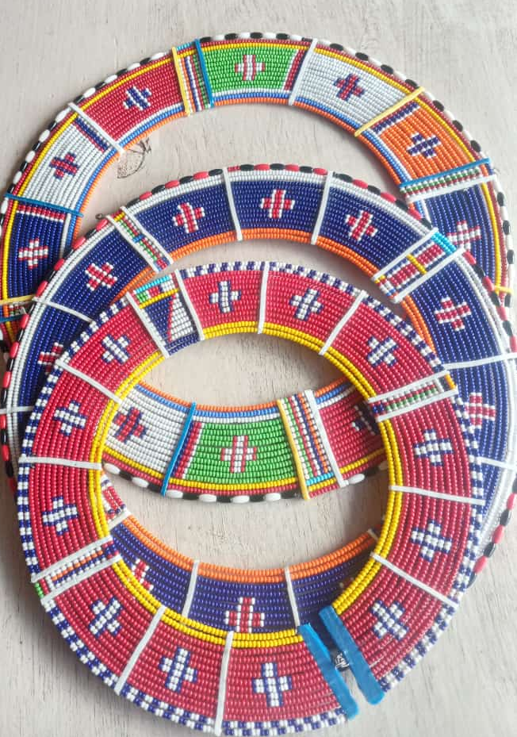
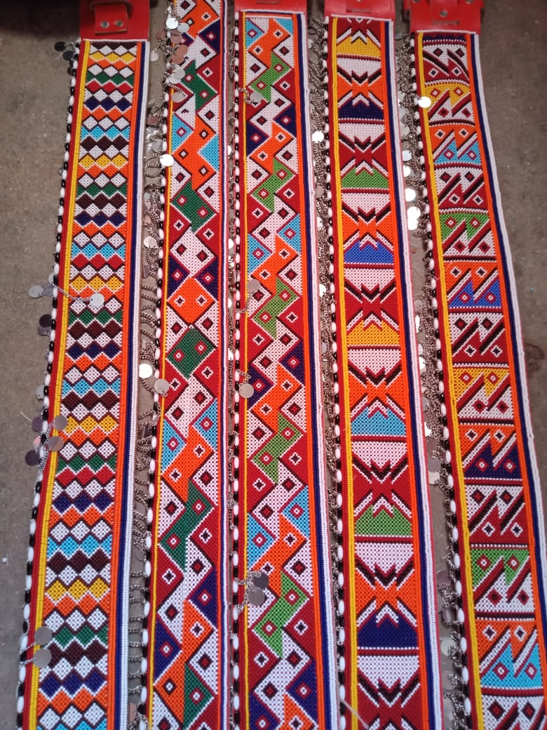
Entrepreneurship and culture
To ensure access to entrepreneurship opportunities and promote positive indigenous knowledge for economic and social benefits
Promote access to Economic & Entrepreunship opportunities for Maasai Indigenous groups.
Use the positive existing indigenous culture for entrepreuniship income.
Train Indigenous women and other groups on other alternatives of income
Improve access and linkages to locals and international markets

Slide 11
Our expectations
Access relevant information through awareness creation, sensitization and education.
Enhanced skills and knowledge within the community
Encourage community participation in all the project stages.
Change of attitude towards among beneficiaries and behavioral changed in projects impact.
Encourage community participation in all the project stage
Enhanced community ownership for management and sustainability.

Slide 12
Key Achievements
Component | Area Kajiado | Activity done | Number reached | Partnership support | Amount from Water Step Organization
Capacity Building | Central-Ildamat | Training on clean and safe water Provision of a bleach maker | 22(3M,19F) | Water Step International Organization. -Ministry Of Health(Public Health Department) -Community Volunteers Erishina Ang CBO | Ksh.25,000/
 | East-Isinya | Training on clean and safe water Provision of a bleach maker | 25(9M,16F) | Water Step International Organization. -Ministry Of Health(Public Health Department Erishina Ang CBO | Ksh. 25,000/
 | Central –Mile Tisa | Training on clean and safe water Provision of a bleach maker | 26(11M,15F) | Water Step International Organization. -Ministry Of Health(Public Health Department) -Community Volunteers Erishina Ang CBO | Ksh.25,000/
 | West -Kilonito | Provision of Water Balls to accessibility | 19 Households | Water Step International Organization. -Community Volunteers Erishina Ang CBO | -

Slide 13
On going projects(Initial stages…..
Bee Keeping and Indigenous Knowledge Documentation
Kajiado East(Oloshaiki Village)
One group
20 members
Kajaido West (Kilonito)
Two groups
20 members each
Kajiado Central
Ildamat (One group-25 members
Matapato South-37 members

Slide 14
Gaps and Opportunities…
GAPS
Opportunities
Organizational Capacity
Financial support limits programs
Geographical nature---vast areas.
The groups we work with are not normally sustained, they break we don’t realize impact.
General lack of information of the most benefits(County government benefits)
An office a place to operate from
Willing volunteers at the community level.
Resource mobilization for both organization and groups.
Focus on registration of groups associations to ensure sustainability.
Enhance community education and sensitization among the groups.
Avenues to leverage resources(County government resources)

Slide 15
End….
THANK YOU

